Slide 1
Labor market Update Q1 2024
Alexandria/Arlington
Marisa Lemma
Research Analyst, Labor Market Intelligence

Slide 2

Employment
Percentage Change in Total Employment, Year-Over-Year
 | Total Employment
 | January 2023 | January 2024
Northern Virginia | 1.56 M | 1.58 M
D.C. MSA | 3.35 M | 3.38 M
United States | 154.77 M | 157.53 M
NOTE: Total nonfarm employment, seasonally adjusted.
Source: U.S. BLS, Current Employment Statistics, March 14, 2024, https://www.bls.gov/ces.

Slide 3
Labor force
 | Total Labor Force
 | February 2020 | January 2024
Alexandria/Arlington | 257.5 K | 264.5 K
D.C. MSA | 3.53 M | 3.48 M
United States | 164.24 M | 166.43 M
Labor Force Change from February 2020
NOTE: Data is not seasonally adjusted. LAUS data from January 2020 – December 2022 were subject to revision on April 21, 2023.
Source: U.S. BLS, Local Area Unemployment Statistics, March 14, 2024, https://www.bls.gov/lau; Current Population Survey, March 14, 2024.

Slide 4
Unemployment
 | Total Unemployed
 | January 2023 | January 2024
Alexandria/Arlington | 6,523 | 5,755
NOVA Region | 39,754 | 34,419
D.C. MSA | 104,388 | 97,566
Trend in Unemployment Rates
NOTE: Data is not seasonally adjusted. Data from January 2020 – December 2022 were subject to revision on April 21, 2023.
Source: U.S. BLS, Local Area Unemployment Statistics, March 14, 2024, https://www.bls.gov/lau.

Slide 5
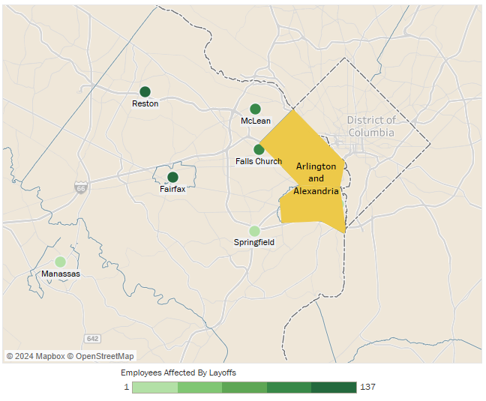
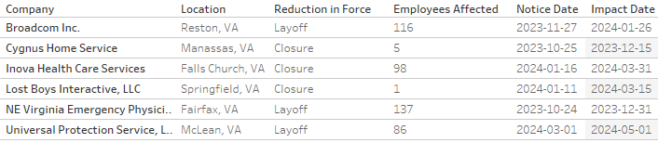
Layoffs
Layoff Notices in Northern Virginia from October 2023 – March 2024
Source: Virginia Employment Commission WARN Notices, March 15, 2024, https://www.vec.virginia.gov/warn-notices.

Slide 6
Unemployment by industry
Percent Change in Unemployment, Jan. 2023 – Dec. 2023
Source: Lightcast Analyst (2024.1 release).

Slide 7
QUESTIONS?
Marisa Lemma
Research Analyst,
Labor Market Intelligence
mlemma@nvcc.edu
Anya Upadhyaya
Research Analyst,
Labor Market Intelligence
aupadhyaya@nvcc.edu
www.nvcc.edu/lmi

