Slide 1


Virginia Talent helps
motivated residents
change their careers and
lives through technology training, job experience,
and mentoring.
Virginia
TALENT

Slide 2



TECH CAREERS FOR ALL
There are thousands of job vacancies in Virginia’s tech sector. Most require a college degree and 2+ years of experience. Virginia Talent fosters engineers to be workforce-ready from day one.
Following intensive training with Exelaration's expert mentors, participants work on client projects to deliver quality technology solutions. The best part? Clients can hire these engineers upon program completion.

Slide 3




JOB CREATION
By upskilling Virginians and transforming them into proficient technologists, the program serves as a catalyst for tech workforce growth, fostering employment opportunities and overall economic prosperity.
WORKFORCE DIVERSITY
Virginia Talent is committed to bringing people of all backgrounds to the tech workforce. By empowering a broader range of Virginians to join the field, the program actively contributes to a more inclusive workforce.
TECH INVESTMENT
Virginia’s businesses need secure, cutting-edge technology to stay competitive. The most trustworthy and efficient team to meet these demands is the local workforce built by Virginia Talent.

Slide 4



CYBERSECURITY
Virginia depends on well-fortified infrastructure and a vigilant cybersecurity force. Virginia Talent trains local citizens on state-of-the-art tools to protect our state’s vibrant digital landscape.
UPWARD MOBILITY
Virginia Talent offers Virginians the opportunity to elevate their career trajectories, harnessing the potential of tech to transition into well-paying and future-proofed roles.
VIRGINIA'S ECOSYSTEM
Virginia Talent takes advantage of the state’s robust workforce toolset:
VITA, GoVirginia, VCCS, SCHEV, Commonwealth Cyber Initiative (CCI),
and Virginia CareerWorks, local economic development agencies, and more.

Slide 5



TECH BEST PRACTICES
By training individuals in proven software development methods and principles, including certified courses in Agile and DevOps, Virginia Talent’s programming is based on best practices.
UNIVERSITY PARTNERSHIPS
Virginia Talent enhances the state's university and community college curriculums with real world projects, creating a seamless transition from education to a software development career.
HOMEGROWN TALENT
Virginia Talent nurtures local talent and exemplifies the potential of not only individuals, but of local businesses like Exelaration to drive positive change within the state’s economic and technological landscapes.

Slide 6

CYBERSECURITY:
BEST PRACTICE PROTECTION
APPLICATION SECURITY
Our cyber engineers ensure that software is built to framework standards from beginning to end of the build process.
SECURITY ENGINEERING
Security engineers ensure every device is protected and up-to-date. We train team members in vulnerability scanning, incident response plans, and ensuring ultimate protection.
RISK AND COMPLIANCE
Analysts focus on research, quantification of enterprise risks, developing risk appetite statements, and prioritization of protection measures. Participants also conduct retrospective assessments and establish critical cybersecurity metrics.

Slide 7
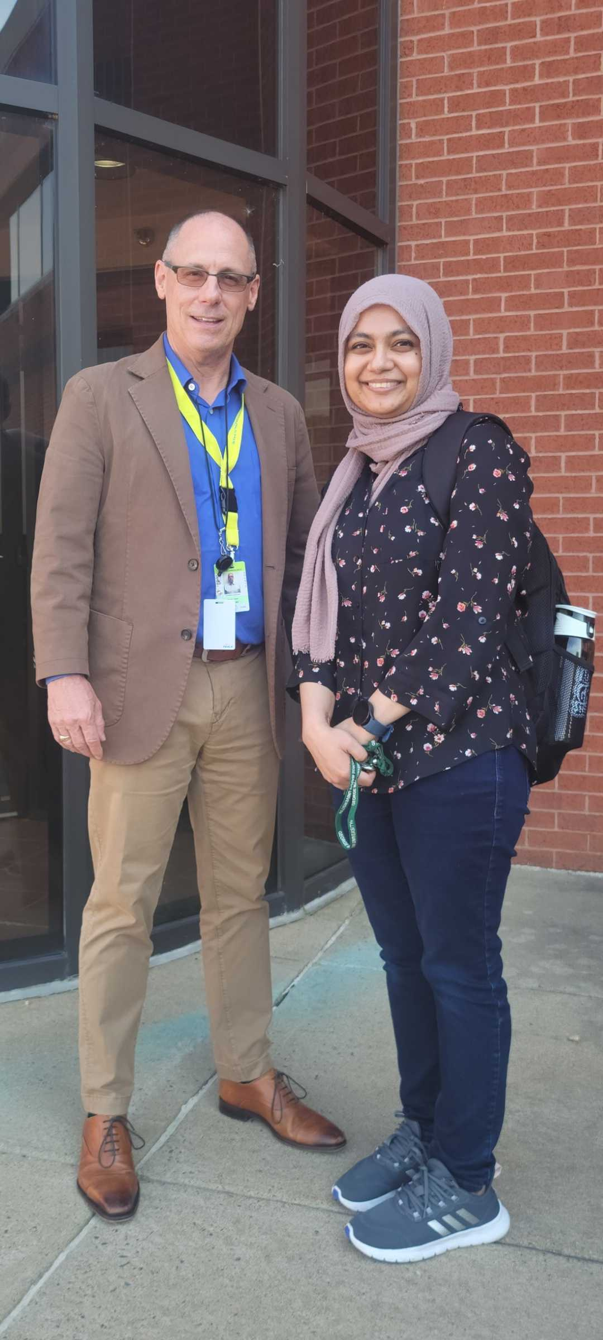
MEET MUNIRA
AN ARLINGTON TALENT PILOT
PROGRAM SUCCESS STORY
Munira joined the Arlington Talent Pilot Program in 2023 to learn from industry experts and enhance her skillsets as an IT professional. Following program completion, she was hired full-time as a technologist for Arlington County.
"The program has made it very easy to improve my skillset and helped me grow as a better engineer. It's an amazing place to start your tech career. You feel valued while working with industry experts that help you gain experience to guide you in your future projects."

Slide 8

100% PROGRAM
COMPLETION RATE
30% AVERAGE PAY INCREASE
38% AVERAGE WORK RATE INCREASE
40 hours
per week
$24.66/hour
$19/hour
28.9 hours
per week

Slide 9

The tech world has made careers in
the field seem so unapproachable and
complex that it's built a self-fulfilling
barrier of intimidation and exclusion.
Virginia Talent gives members of our community the experience and confidence they need to overcome this obstacle.
EXELARATION CEO STEVE COOPER

Slide 10

THE TECH TALENT CRISIS
  Without expanding access to the tech talent pipeline, almost 60,000 positions in the DC-metro area will go unfilled in 2023
  By 2025, the forecasted supply gap is about 50% for tech talent and 67% for tech adjacent talent
“The U.S. needs to make a lot more use of programs that enable people without four-year degrees to attain quality, high-paying jobs.”
- Condoleezza Rice

Slide 11

PROGRAMS TAILORED
FOR YOU
VIRGINIA TALENT IS FULLY CUSTOMIZABLE FOR YOUR GOALS
  Timeline
  Budget
  Tech stacks
  Participant requirements

Slide 12
SAMPLE CAREER DEVELOPMENT PROGRESS MAP
INDEPENDENT
TEAM ROLE
PRE-PROGRAM
2-3 MONTHS
MENTORED TRAINING
10 WEEKS
PAID
PROJECT ASSIGNMENT
10 WEEKS
PAID
CONTINUE IN
PROJECT ROLE
ELIGIBLE FOR HIRE
  SELF STUDY
  CODING PRACTICE
  DEDICATED MENTOR OVERSIGHT
  INDIVIDUAL CODING PROJECTS
  DEDICATED MENTOR OVERSIGHT
  SUPERVISED SOFTWARE DELIVERY IN PROJECT ENVIRONMENT
HIRED AS SOFTWARE
ENGINEER ANYWHERE
APPLICATION
& ACCEPTANCE
CHECKPOINT
PROGRAM COMMENCEMENT

Slide 13

















Slide 14



ABOUT EXELARATION
Top organizations engage Exelaration to design and build custom software to improve their business. Anchored by experts with decades of experience across a variety of tech stacks, we mobilize development teams of early career developers to complete real client projects.
We’ve delivered solutions for startups, Fortune 500 companies, federal agencies, non-profits, and associations. Exelaration clients cite our mission, capabilities, and communication as the reason they continue to choose us as their technology partner, Agile advisor, and even fractional CTO.

