Slide 1



Northern Virginia Senior Community Service Employment Program (SCSEP)
Notes:
The Senior Community Service Employment Program (SCSEP) is a grant funded program authorized by the Department of Labor. This is a national program; we operate the Northern Virginia project which covers 12 counties. As you can see below, there are 3 logos. NCOA is the grantee and we operate the program through SkillsSource and the Virginia Career Works as the subgrantee.

Slide 2
The Northern Virginia
SCSEP covers the counties and cities of:
Alexandria, Arlington, Clarke, Fairfax, Fauquier,
Loudoun, Manassas, Manassas Park,
Page, Prince William, Rappahannock, and
Warren.
Northern Virginia Senior Community Service Employment Program (SCSEP)
Notes:
The Senior Community Service Employment Program (SCSEP) is a grant funded program authorized by the Department of Labor. This is a national program; we operate the Northern Virginia project which covers 12 counties. As you can see below, there are 3 logos. NCOA is the grantee and we operate the program through SkillsSource and the Virginia Career Works as the subgrantee.

Slide 3

What is SCSEP?
The Senior Community Service Employment Program (SCSEP) provides subsidized community services and employment training to unemployed, income eligible job seekers aged 55+
Participants receive a stipend while attending training, searching for a job, and building their skills at a local nonprofit organization.
Temporary community service training can be used as a bridge to find employment opportunities outside of the program.
Notes:
SCSEP is a community service and job training program for job seekers that are 55 and above, currently unemployed and meet the income requirements. SCSEP provides participants with community service training opportunities to build their skills, confidence and employability all while earning a stipend for training.

Slide 4
SCSEP Services
SCSEP provides participants with other training and support services that are important for finding future employment, including:
  Individual Employment Plan (IEP) development
  Specialized training to prepare for placements
  Assistance in securing future employment
  Access to Virginia Career Works Centers
  Supportive Services
Notes:
• SCSEP also provides supportive services to participants. Some of the supportive services include:
• IEP: the initial IEP will help to identify the clients goals and make a plan. This will be reviewed and completed every n 6 months.
• Specialized training, we provide classes focusing on specific skills.
• Assistance in secure future employment, we connect SCSEP participants with resources, job developers, lists of job postings , and employer events where they have the opportunity to apply for those available openings and meet employers
• Virginia Career works provides assistance with Job coaching, job developer, write or upgrade the resume, interviewing skills, Annandale office is open by appointments, where also clients can use the computers, printer, fax .

Slide 5
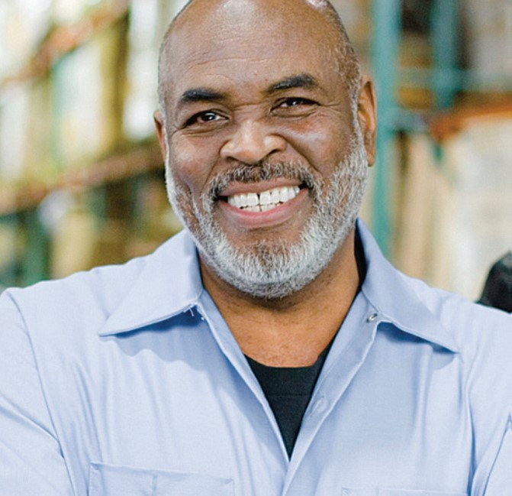
Eligibility Requirements
Participants must be:
  Age 55+
  Unemployed
  A resident of Northern Virginia
  Able to meet income criteria:
Household income up to 125% of Federal Poverty Level
Family of 1 | Family of 2 | Family of 3 | Family of 4 | Family of 5
$18,225 | $24,650 | $31,075 | $37,500 | $43,925
Add $6425 for each additional person
Notes:
These chart shows the income eligibility guidelines for enrollment in SCSEP. Income may not exceed 125% of the federal poverty level.

Slide 6
Eligibility: Priority of Service
Priority of service is given to individuals who meet one or more of the following categories:
  Veterans and qualified spouses
  Over the age of 65
  Living with a disability
  Low literacy skills or limited English proficiency
  Reside in a rural area
  Homeless or at risk of homelessness
  Low employment prospects
  Failed to find employment after using services through the American Job Center system
Notes:
Priority of Services, we make sure to give priority to individuals under these categories, recently another category was included, for a participant who was incarcerated and released in the last 5 years.

Slide 7
Training
SCSEP offers a variety of temporary community service training positions at both nonprofit and public facilities, designed to provide the skills and experience necessary to obtain future employment outside the program. Training sites may include:
Additional training through lectures, seminars, one-on-one instruction and training programs.
Training can be done Monday through Friday for up to 20 hours a week (weekly hours may vary throughout participation) and cannot exceed 8 hours daily.
Participants receive a biweekly stipend for training hours at minimum wage.
  Shelters
  Schools
  Senior Centers
  Government agencies
  Libraries
  Recovery Centers
Notes:
Training assignments are temporary training positions at nonprofit or public facilities where clients learn and update skills to prepare them employment. Particpants are assigned to a host site to conduct their weekly training hours. Currently in the transition to place all participants in a Host site.

Slide 8

Next Steps
Applicants will need to provide:
Completed enrollment packet
Copies of the following eligibility documents:
  Two forms of ID, one must be a picture ID (ex. Driver’s license, Passport);
  Social Security card (copy of both sides);
  A utility bill on your name and current address;
  Benefit award letter(s) for anything you receive from social security (SSA, SSI, SSDI);
  SNAP letter (if applicable);
  Your last 3 months of bank statements if you have not worked in the last 6 months OR your last 6 months of bank statements and paystubs if you have worked in the last 6 months;
A voided check;
Third-Party Attestation Form (completed by a friend or neighbor)
Need
Assistance?
Contact Debbie Fletcher by email at dfsscsep@fairfaxcounty.gov
or by phone at 703-488-8196, 711 VA Relay
Notes:
How do you enroll in SCSEP? Fill out an enrollment packet, provide a copy of your verifications and supporting documents, verify income sources and provide direct deposit information.

Slide 9
Frequently Asked Questions
If I work part-time, am I eligible for SCSEP?
No, you are not eligible for SCSEP if you are working any number of hours.
I receive Social Security, does that make me ineligible for SCSEP?
It depends. Social Security Disability Income (SSI and SSDI) is not counted when determining income eligibility for SCSEP. However, regular social security income is counted. Eligible participant income must fall under 125% of the Federal Poverty Level based on the household size.
How do I get the SCSEP enrollment packet?
Eligibility forms can be requested via email at DFSSCSEP@fairfaxcounty.gov or by calling Debbie Fletcher at 703-488-8196.
If I get a part-time job while in SCSEP, can I continue to participate in the program?
No, once you are employed for any number of hours you will need to leave the SCSEP program. The day you start your new job is your last day in SCSEP.

Slide 10
Frequently Asked Questions
If I live with my adult children, do their incomes count when determining SCSEP eligibility?
No, only the income for the applicant and spouse is counted.
If I am disabled, do you count my spouse’s income?
No, SCSEP does not count the spouse’s income when an applicant is considered SSI or SSDI disabled. This applicant is considered a household of one under SCSEP eligibility.
As a participant with a disability, what are my options for training at a host site?
SCSEP will work with participating Host Sites to make accommodations for disability and/or priority of service persons.
I was incarcerated, am I eligible for the SCSEP program?
Yes, persons with justice system involvement are a priority of service group for SCSEP if they meet the other eligibility criteria.

Slide 11


Thank you!
Linda Siam
Linda.Siam@fairfaxcounty.gov
Produced by the Virginia Career Works-Fairfax Centers,
operated by Fairfax County Department of Family Services
Public Assistance and Employment Services
Fairfax County, VA
www.fairfaxcounty.gov/familyservices

