Slide 1
Alexandria/Arlington
Regional Workforce Council
Serves as the local Workforce Development Board under the federal Workforce Innovation and Opportunity Act (WIOA).
Comprised of individuals representing business, economic development, housing and urban development, vocational rehabilitation, organized labor, and community-based organizations.
Members of the Council are appointed by the Mayor of Alexandria City and the Arlington County Board Chair.
Provides oversight over WIOA services at the region’s two American Job Centers, the Alexandria Workforce Development Center and the Arlington Employment Center.
Services include financial support for college tuition and vocational certifications, subsidies for transportation, books and fees while in school, and uniforms for employment.

Slide 2





























Our Members

Slide 3
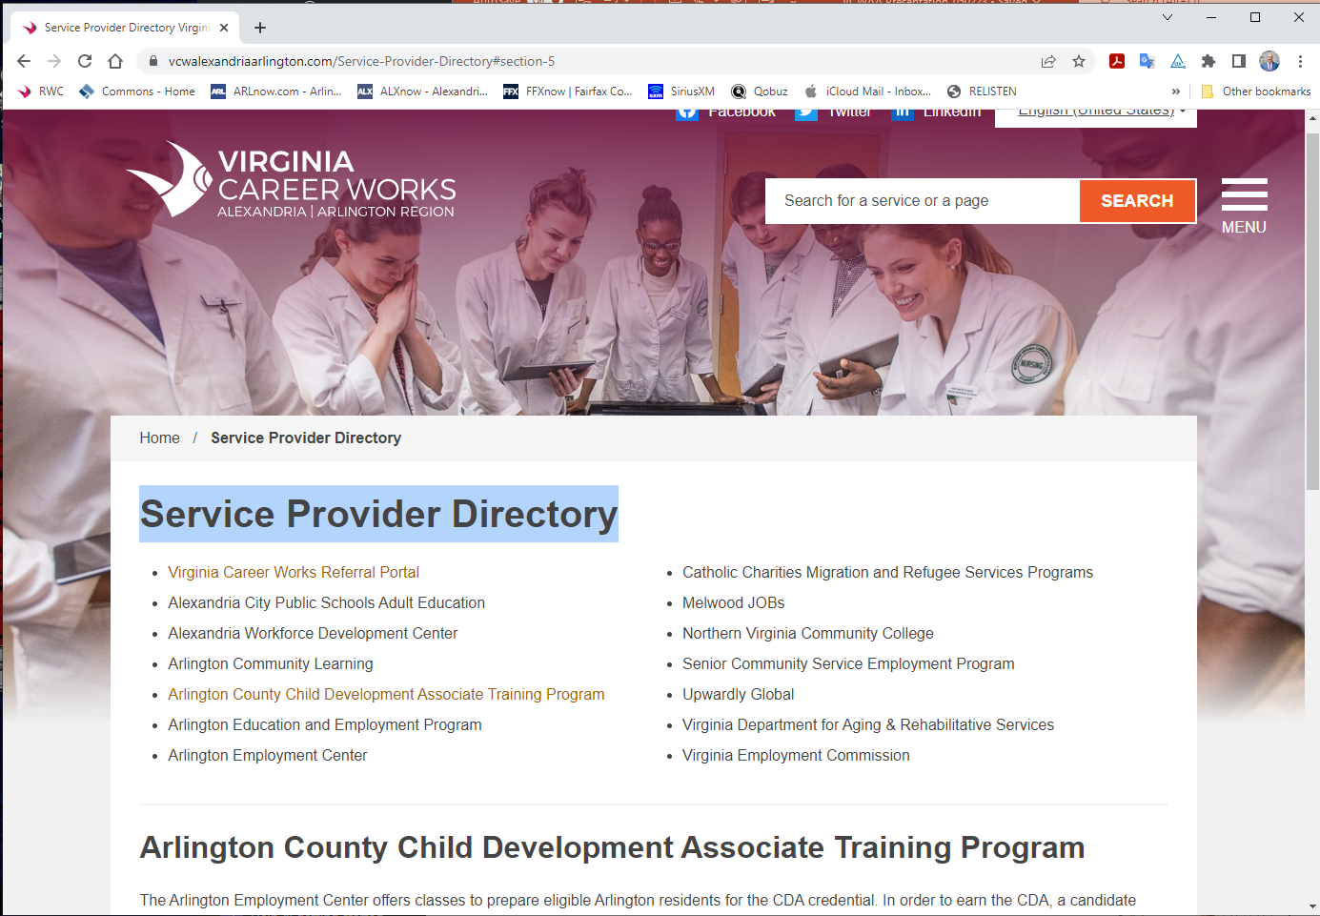
Service Provider Directory

Slide 4
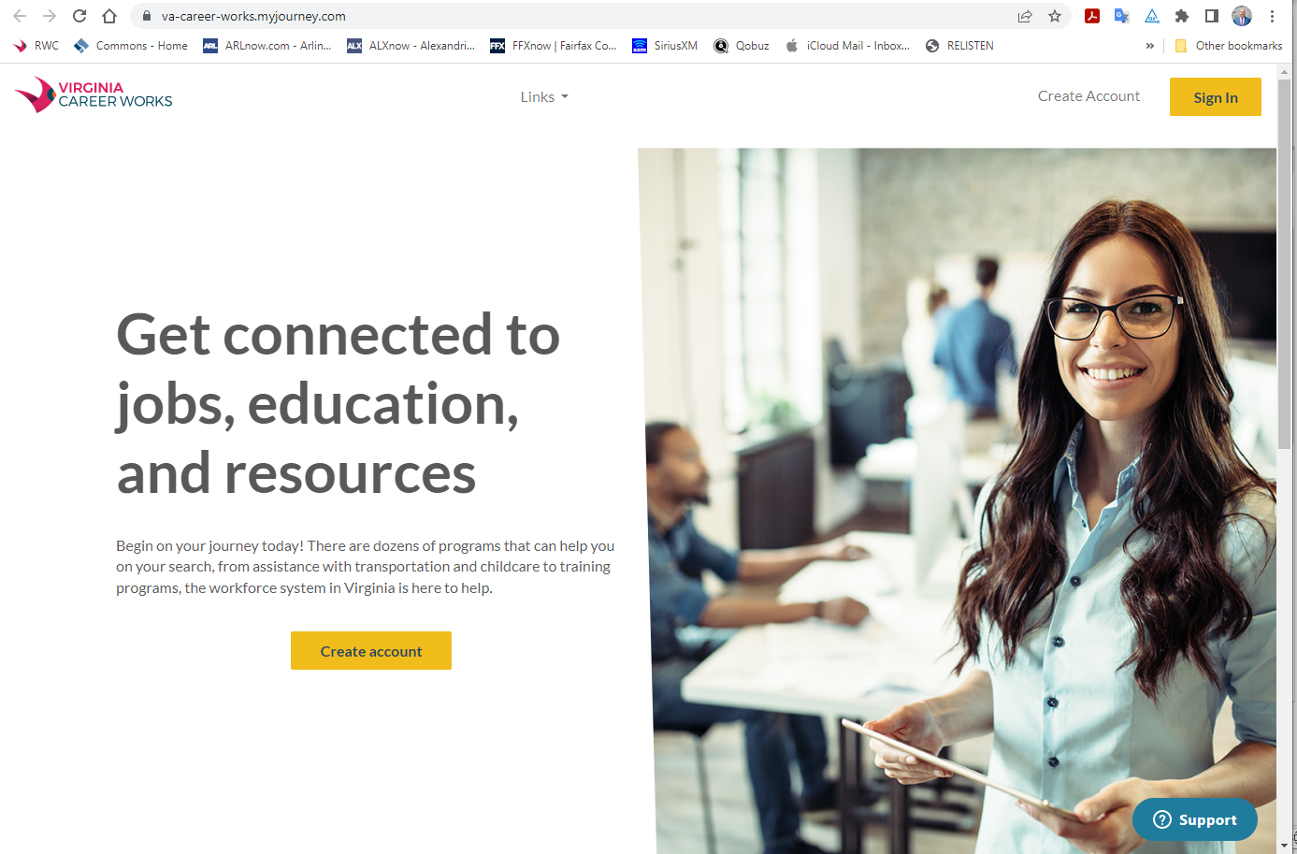

Slide 5
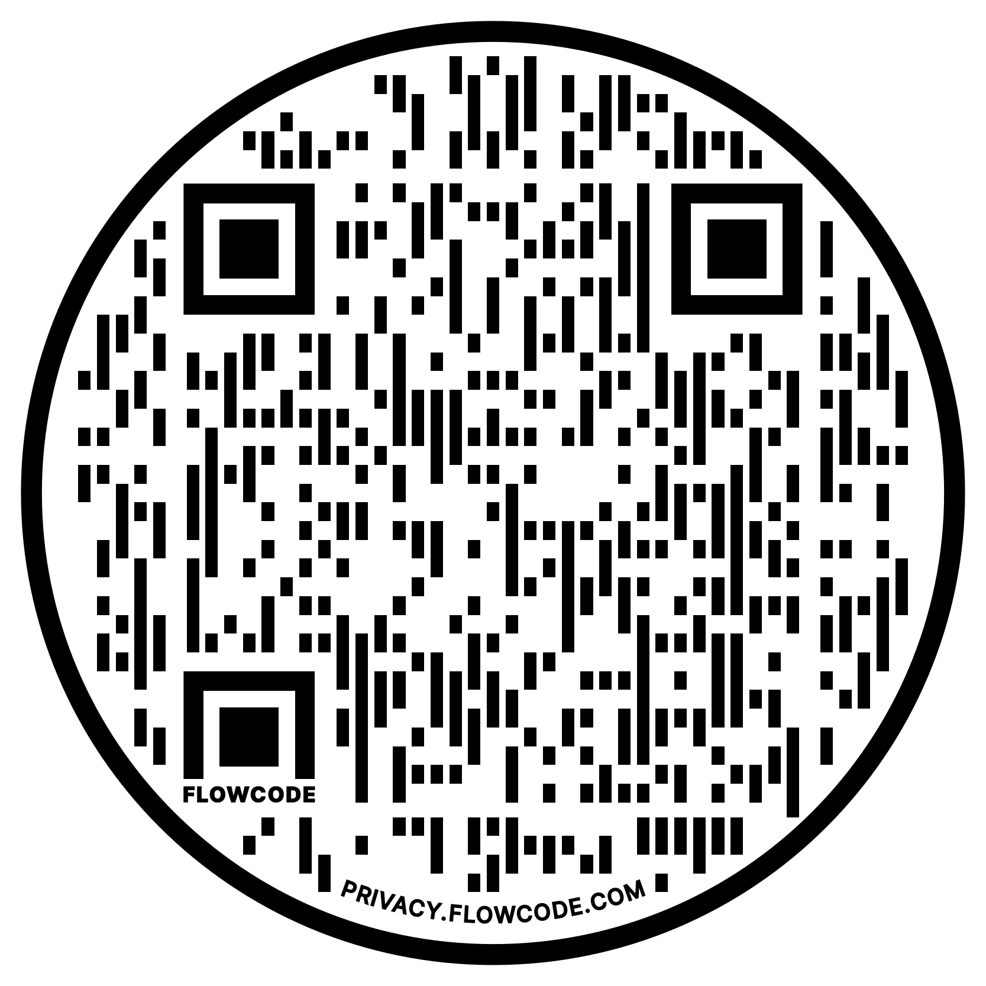
Arlington Employment Center
Computers, internet, copiers, scanners, and fax machine for your job search
Resume building software and Microsoft Word, Excel, PowerPoint, and Skill-up!
Search available jobs and post your resume on our job boards
On-site & virtual hiring events and job fair information
Job search, basic professional skills, resume writing, and social media workshops
Career counseling, assessment, and training services
Employment services for Veterans
Access to English for Speakers of Other Languages (ESOL) classes
Accommodations and assistance for people living with disabilities
Recruitment assistance services & support to “skill-up” your staff
Find Us At
aec.arlingtonva.us 703.228.1400

Slide 6
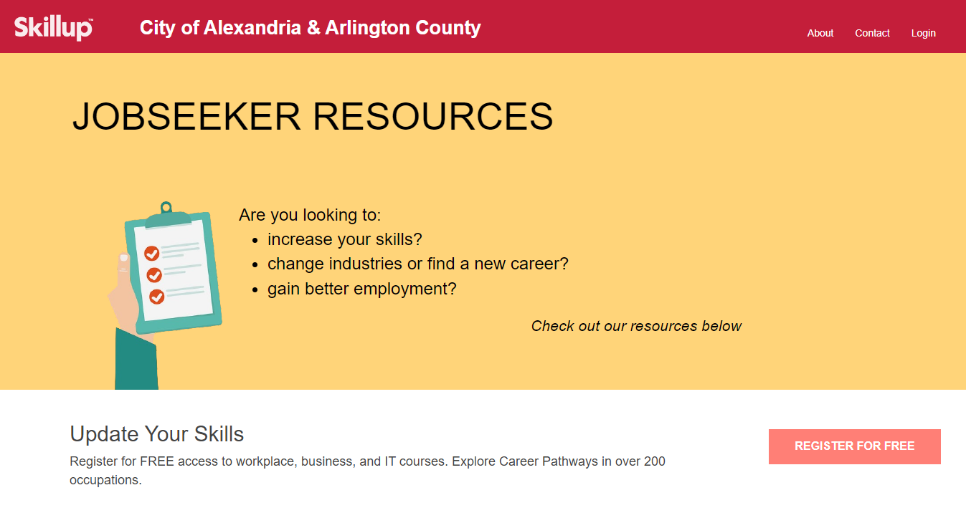
alexandriaarlington.skillupamerica.org

Slide 7
Arlington Employment Center
Computers, internet, copiers, scanners, and fax machine for your job search
Resume building software and Microsoft Word, Excel, PowerPoint, and Skill-up!
Search available jobs and post your resume on our job boards
On-site & virtual hiring events and job fair information
Job search, basic professional skills, resume writing, and social media workshops
Career counseling, assessment, and training services
Employment services for Veterans
Access to English for Speakers of Other Languages (ESOL) classes
Accommodations and assistance for people living with disabilities
Recruitment assistance services & support to “skill-up” your staff
Find Us At
aec.arlingtonva.us 703.228.1400

Slide 8
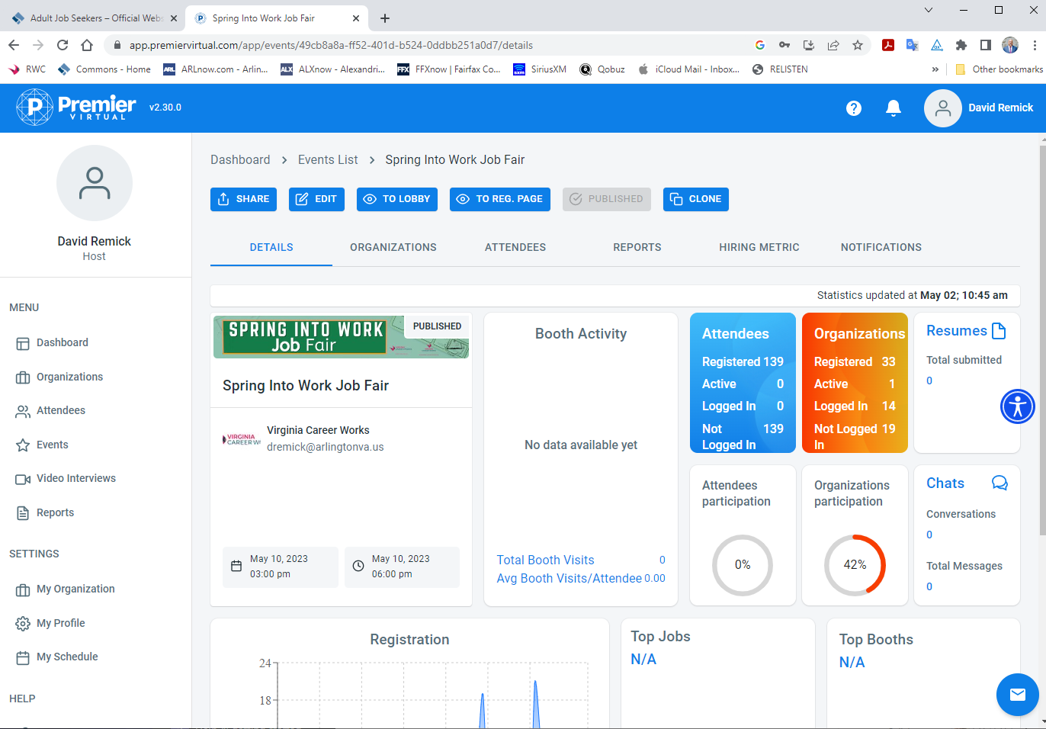

Slide 9
Arlington Employment Center
Computers, internet, copiers, scanners, and fax machine for your job search
Resume building software and Microsoft Word, Excel, PowerPoint, and Skill-up!
Search available jobs and post your resume on our job boards
On-site & virtual hiring events and job fair information
Job search, basic professional skills, resume writing, and social media workshops
Career counseling, assessment, and training services
Employment services for Veterans
Access to English for Speakers of Other Languages (ESOL) classes
Accommodations and assistance for people living with disabilities
Recruitment assistance services & support to “skill-up” your staff
Find Us At
aec.arlingtonva.us 703.228.1400

Slide 10
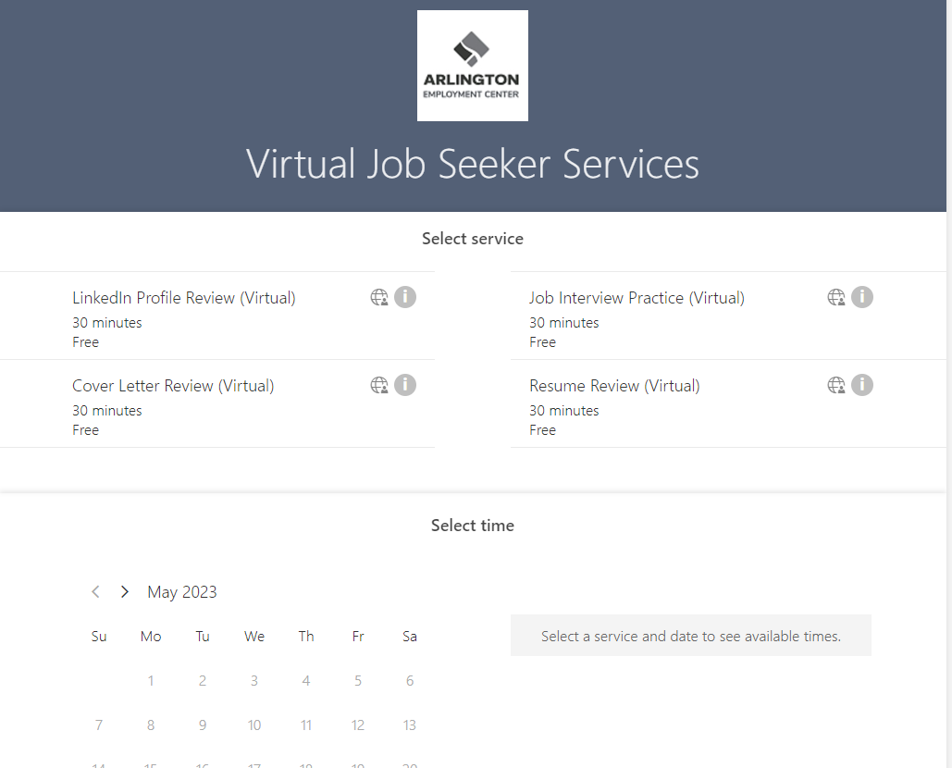

Slide 11
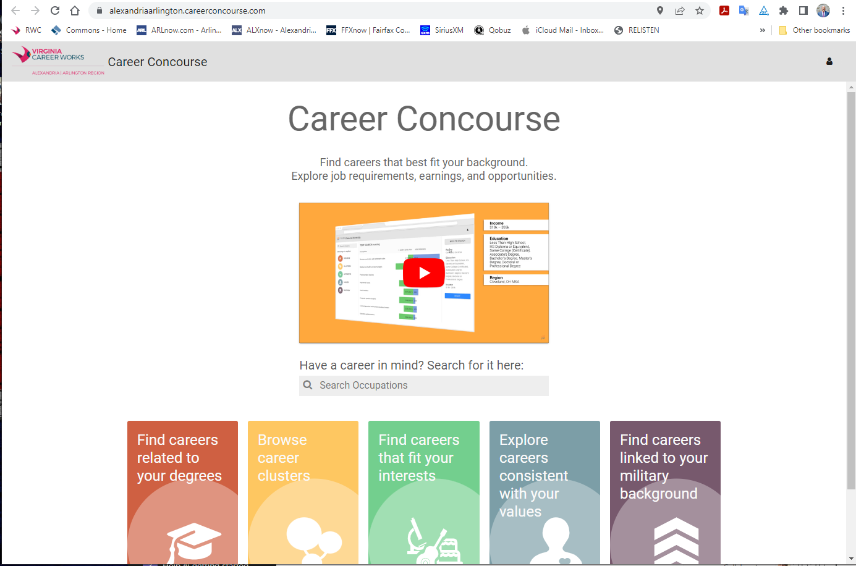

Slide 12
Arlington Employment Center
Computers, internet, copiers, scanners, and fax machine for your job search
Resume building software and Microsoft Word, Excel, PowerPoint, and Skill-up!
Search available jobs and post your resume on our job boards
On-site & virtual hiring events and job fair information
Job search, basic professional skills, resume writing, and social media workshops
Career counseling, assessment, and training services
Employment services for Veterans
Access to English for Speakers of Other Languages (ESOL) classes
Accommodations and assistance for people living with disabilities
Recruitment assistance services & support to “skill-up” your staff
Find Us At
aec.arlingtonva.us 703.228.1400

Slide 13
Ticket to Work
What is Ticket-to-Work?
  The Ticket-to-Work is a free and voluntary program that provides beneficiaries with an array of services to assist them in successfully entering into and remaining part of the workforce.
Who can participate in Ticket-to-Work?
  Anyone receiving Social Security Disability Insurance (SSDI) or Supplemental Security Income (SSI) benefits due to disability between the ages of 18 and 64 and wants to increase their monthly financial outcomes.
Why should I join Ticket-to-Work?
  Ticket-to-Work exists to help disability beneficiaries gain the confidence to go back to work, knowing exactly what the impact on their benefits will be and when, as well as arrive at a point where they are working towards self-sufficiency and financially independence.
For more information, please contact Spencer Wilkinson at swilkinson1@arlingtonva.us.

Slide 14

Contact
David Remick
Direct: 703.228.1412
Email: dremick@arlingtonva.us
Web: vcwalexandriaarlington.com
Twitter: ‎‎‎@workcouncil
VA Relay 711

