Slide 1



WDC Updates and Information
We're happy to help you get started.

Slide 2

Step 1: Attend Orientation
Step 2: Submit your current resume for review
*We may require you to take the resume writing workshop*
Step 3: Participate in a mock (practice) interview and receive feedback on what you did well and where you can improve
Step 4: Meet with WDC to explore employment possibilities and options, which could include referrals to partner agencies for specialized support
WDC Next Steps for Jobseekers (Required)

Slide 3

Career Center Services
  Open 8:30am to 4:30pm
  Monday through Friday​
  Computers available for email, job searching, and resume writing​
  Printer​ access
  Staff to offer limited tech support as you use the center​

Slide 4
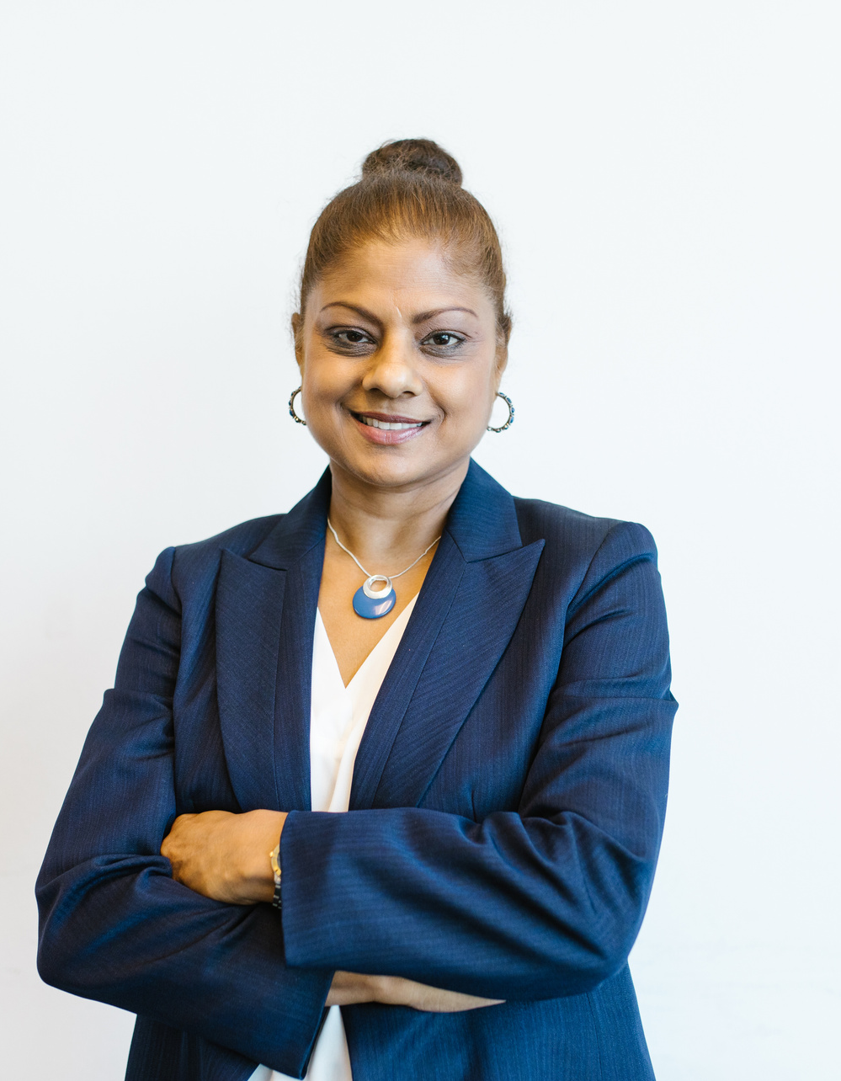




1:1 Job Coaching
Mock Interviews
Our Business Services (BSU) team members provide personalized one-on-one coaching to help prepare job-seekers.
WDC provides in-person mock interview sessions facilitated by experienced professionals in various fields.
Career Readiness Workshops
Resume Writing
This virtual workshop provides the necessary tools needed to prepare, update or modify your resume for job seeking opportunities.

Slide 5
WDC Eventbrite Page -- You can see all our upcoming workshops and job fairs! https://www.eventbrite.com/o/city-of-alexandria-workforce-development-center-2133260017
WDC website as new information is added frequently. https://www.alexandriava.gov/WorkforceDevelopment
Alexandria Youth Job Fair (open to all -- see flyer in the chat)
We are also looking for businesses who are interested in participating in the two-day event!
Work Based Learning update: Registration is currently closed due to high volume of applicants. We plan to re-open registration in the summer.
All partners have been invited back to WDC - Catholic Charities, Melwood, DARS and VEC. We are waiting on some approvals and documents and look forward to having them back onsite in near future.
Come see us! 4850 Mark Center Drive, 6th Floor, Alexandria VA 22311
Check it out!

Slide 6

Christina Damhuis
Employment Navigator
christina.damhuis@alexandriava.gov
571-447-6566

