Slide 1

CTE &
Workforce Development
Wednesday, May 2, 2023\\

Slide 2

Profile of a
Virginia Graduate
Achieve and apply appropriate academic and technical knowledge
Content
Knowledge
Align knowledge, skills, and personal interests with career opportunities
Career Planning
Workplace Skills
Community & Civic
Responsibility
Attain and demonstrate productive workplace skills, qualities, and behaviors
Build connections and value interactions with diverse communities
Notes:
Profile of Virginia Graduate
Participating in WBL helps students achieve the Profile of a Virginia Graduate.
The 3 criteria of High-Quality WBL reinforce the 4 components that make up the Profile of a Virginia Graduate (content knowledge, career planning, workplace skills, and community & civic responsibility)
Related to students’ career goals and/or interests (career planning)
Integrated with instruction (connected to CTE content knowledge)
Performed in partnership with local businesses and organizations (workplace skills, worksite in the community)

Slide 3
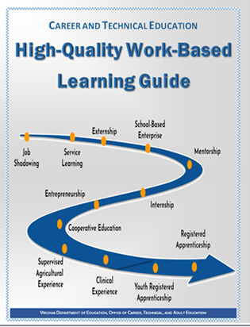
What is High-Quality Work-Based Learning?
WBL provides relevance and meaning to what students are learning through hands-on experiences.
Students develop relevant employability skills.
Students are given a chance to apply classroom
learning at the workplace and bring workplace
knowledge back to the classroom.
ACPS helps students identify workplace experiences related to their career interests or goals. ACPS also partners with employers to match up students interested in their place of work.

Slide 4
Work-Based Learning Experiences
Job Shadowing
Service Learning
Mentorship
School-Based Enterprise
Externship
Internship
Entrepreneurship
Clinical
Cooperative Education
Youth Registered Apprenticeship
Apprenticeship

Slide 5

High-Quality WBL Experiences
Grades 6-12
Grades 9-12
Externship
Job Shadowing
Service Learning
Mentorship
School-Based Enterprise
Internship
Supervised Agricultural Experience*
*Added July 1, 2021
Cooperative Education
Registered Apprenticeship
Entrepreneurship
Clinical Experience
Youth Registered Apprenticeship
Notes:
High-Quality WBL Experiences
High-Quality Work-Based Learning (WBL) is comprised of experiences related to students’ career interests, based on instructional preparation, and undertaken in partnership with local businesses or organizations. The Virginia Department of Education (VDOE) recognizes 12 WBL experiences. These 12 WBL experiences promote the following:
Career Awareness
Career Exploration
Career Preparation
This diagram identifies the 12 WBL methods practiced in Virginia and what grade levels the experiences can be offered to students. The experiences for students begin with less intense opportunities such as job shadowing, to more intensive opportunities such as cooperative education and youth registered apprenticeship.

Slide 6
CTE Reporting for the State
• # of students by WBL Experience (and by Employer)
• # of business partners by cluster
• # of business partners by WBL Experience

Slide 7
Communication Process
Central Office CTE & Workforce Development Office
School Counseling Center School College & Career Center
Parents, Teachers, & Students

Slide 8
Process for Communicating Work-Based Learning Opportunities with ACPS
Send information about the WBL opportunity to the
CTE & Workforce Development (CTE & WfD) Office tricia.jacobs@acps.k12.va.us and sarah.black@acps.k12.va.us
2. CTE & WfD Office will send an email confirming receipt of the information.
3. An invite will be sent for a brief virtual meeting and a brief business partner interest form will be sent.
4. Potential partner completes the interest form.

Slide 9
Process (continued)
5. An email will be sent to the contact person to schedule a site visit.
6. An online background check will be conducted.
7. Site visit.
8. A Partnership Agreement for signature .
9. Send welcome email to new partner.
10. WBL Specialist will assist in creating the Student Training Agreement and Plan

Slide 10

Student Benefits
Employability and technical skills
Social capital
Positive relationships and networking
Workplace environment experiences
Academic excellence and opportunities for advancement
Pathways to careers
Notes:
Student Benefits
Students’ knowledge, skills, and attitudes are enhanced by participation in supervised, authentic experiences. WBL experiences are valuable because they help students develop careers beyond their secondary and postsecondary education. Students who participate in WBL experiences are often able to continue to work for their placement companies after high school graduation or even after college graduation. Furthermore, employers are increasingly seeking new hires who have WBL experience and can perform well from day one.
Student benefits include:
Employability and technical skills (understanding how to apply knowledge that’s necessary to complete job requirements)
Social capital (developing the ability to communicate and socialize with individuals on all levels; their peers, all customers, supervisors and top management)
Positive relationships and networking
Workplace environment experiences
Academic excellence and opportunities for advancement
Pathways to careers
Students that participate in WBL are better prepared to transition into the workforce and into higher education.

Slide 11

Business Partner Benefits
Contribute to economic growth
Increase workforce diversity and inclusion
Enhance educational curriculum
Prepare youth for evolving workforce by providing employment opportunities
Meet current workforce needs
Establish a network with other businesses/employers
Increase customer awareness, which should lead to an increase in the bottom-line
Notes:
Business Partner Benefits
As a WBL advocate, you must tell the story! This is the beginning of a beautiful relationship, once business partners understand their benefits!
Business partner benefits include:
Contribute to economic growth (stress how the individual business prepares students to transition into the workforce, therefore increasing the number of individuals employed and decreasing unemployment)
Increase workforce diversity and inclusion (closing the skill gap by providing all students the opportunity to participate in High-Quality experiences)
Enhance educational curriculum (collaborate with educators)
Prepare youth for evolving workforce by providing employment opportunities
Meet current workforce needs
Establish a network with other businesses/employers
Establish a positive reputation, image and identity within the community
Increase customer awareness, which should lead to an increase in the bottom-line

Slide 12
Job Shadowing
Example: A student observes an architect at a local architectural design company.
Job Shadows place students in workplaces to interact with and observe one or more employees
May be in person, virtual, a one-on-one interaction or a group experience
Does not count towards CCCRI or graduation requirements
WBL Experience | Training agreement | Training plan | Suggested Grade levels | Related CTE instruction | Minimum duration | Paid option | Meets Graduation Req | Credit option
Job Shadowing | ✅ | ⛔ | 6-12 | ✅ | Varies by type | ⛔ | ⛔ | ⛔
Notes:
Job Shadowing
Job Shadowing is an excellent foundational experience for students; it allows them to explore careers and observe a workplace to get a feel for a position. It can be in-person, or virtual. There is no minimum duration but it is typically a lower intensity experience, potentially only a few hours. For this reason, although job shadowing is considered a high-quality work-based learning experience, due to the lower intensity, it does not count towards the graduation requirement for students or the CCCRI for school accreditation.

Slide 13
Externship
Example: A student observes a store manager conducting new employee training for 1-2 hours per week throughout the year.
An extended job shadowing experience designed so students may ask questions, observe, and get a feel for the work environment
Must be a minimum of 40 hours total
Work is not delegated and projects are not assigned
WBL Experience | Training agreement | Training plan | Suggested Grade levels | Related CTE instruction | Minimum duration | Paid option | Meets Graduation Req | Credit option
Externship | ✅ | ⛔ | 6-12 | ✅ | 40 hours | ⛔ | ✅ | ⛔
Notes:
Externship
A job shadowing experience that totals a minimum of 40 hours is considered an externship and does meet the criteria for fulfilling a work-based learning experience as a part of the graduation requirements for students. The 40 hours can take place at any time during the duration of the CTE course (i.e., 1-2 hours per week throughout the year, all at once in a whole work week, five full 8 hour days, etc.)

Slide 14
Service Learning
Example: Students in Engineering Studies identify a need, conduct research, and design a plan to solve the problem.
Goes beyond community service to identify an interest or community need and develop and complete a project
Structured activities before, during, and after the experience by the student to reflect and self-assess
Can take place in conjunction with CTSO experiences
WBL Experience | Training agreement | Training plan | Suggested Grade levels | Related CTE instruction | Minimum duration | Paid option | Meets Graduation Req | Credit option
Service Learning | ✅ | ⛔ | 6-12 | ✅ | Varies by type | ⛔ | ✅ | ⛔
Notes:
Service Learning
Service learning allows students to give back to the community by identifying a need, conducting research, planning and executing a project, and reflecting on the experience. It goes beyond community service for a number of reasons:
It must meet the (8) standards from the National Youth Leadership Council
It must connect to the content of the CTE course (students conduct research in the content area and connect topics learned in the course to the project)
There is no minimum duration to allow for flexibility, but must be sufficient time throughout course duration to meet expectations

Slide 15
Service Learning vs. Community Service
Service Learning is High-Quality Work-Based Learning
Students identify an interest and a community need.
Students develop and complete a service project addressing the community need.
Students complete structured activities before, during, and after the experience.
Students reflect and self-assess.
Community Service is not High-Quality Work-Based Learning
The community need may already be established.
Students participate in voluntary assignments and activities to serve organizations and/or individuals within the community.
Community service may or may not align with school-based instruction.
Notes:
Service Learning vs. Community Service
This slide highlights the key differences between service learning and community service. Having the word “service” in both terms can be confusing but they cannot be used interchangeably; service learning is high-quality WBL and community service is not. Students participating in service learning need to be actively involved in identifying the community need, whereas with community service they may be participating in a voluntary role where the need has already been established. For example, during a blood drive, can drive, or school clean-up, students may sign up for 1-2 hour shifts. While these types of projects are beneficial and helpful to the community and should continue, they are not high-quality service learning projects unless they involve deep student involvement with the planning, research, and most importantly, connection to the CTE content in the course.

Slide 16
Mentorship
Example: A Sports and Entertainment Marketing student participates in a mentorship with a brand manager to learn more about the career.
Pairs student with an industry professional for a long-term relationship focused on growth and development
Documented hours working with a mentor may include: discussion/reflection, observation of workplace, collaborative research and exploration of the career field
Only counts towards CCCRI or graduation requirements if student earns 140 hours
WBL Experience | Training agreement | Training plan | Suggested Grade levels | Related CTE instruction | Minimum duration | Paid option | Meets Graduation Req | Credit option
Mentorship | ✅ | ⛔ | 6-12 | ✅ | Course duration or 140 hours for 0.5 credit | ⛔ | Mentorships over 140 hours | ✅
Notes:
Mentorship
Mentorships are another excellent opportunity for students in grades 6-12 to explore a career in partnership with a mentor. Mentorships can be similar to job shadowing or externships where a student is involved with observing an employee at a workplace, but a mentorship allows for a longer-term relationship and more in-depth activities like discussion and reflection, research and exploration of the career field, and even small hands-on tasks if deemed appropriate by the mentor. Mentorships can only count for a student towards the graduation requirement and CCCRI if they are a minimum of 140 hours, and if a student earns 140 hours they can receive an additional 0.5 course credit in addition to the CTE course credit being earned in connection with the mentorship.

Slide 17
School-Based Enterprise
Example: Culinary Arts students work in the café on school grounds, communicating with vendors to purchase supplies, managing funds, and making business-related decisions.
An on-going student managed, entrepreneurial
operation within a school setting
Provides goods and services that meet the needs of
the school’s target markets
Is a collaboration between the teacher and student with management decisions made by the students
Examples:culinary cafe, greenhouse, childcare program, retail store, credit union, automotive & carpentry services
WBL Experience | Training agreement | Training plan | Suggested Grade levels | Related CTE instruction | Minimum duration | Paid option | Meets Graduation Req | Credit option
School-Based Enterprise | ✅ | ⛔ | 6-12 | ✅ | Course duration | ✅ | ✅ | ⛔
Notes:
School-Based Enterprise
School-Based Enterprises are high-quality WBL experiences that are already taking place effectively throughout the Commonwealth. Many of our schools have culinary cafes, greenhouses, auto repair shops, credit unions, and more. In order for a school-based enterprise to be considered high-quality, students must be the main decision makers of the business and must be directly involved with all aspects of running the business. There is no specific minimum requirement of hours to allow for flexibility, but students should be working in the business throughout the duration of the course. Students may be paid or unpaid for their services, but cannot earn additional course credit for the hours worked beyond the course credit earned in the CTE course in connection with the experience.

Slide 18
Entrepreneurship
Example: A Design Multimedia student creates logos and designs websites for vendors in the community, charging fees and managing all aspects of the business.
Students plans, implements, operates, and assumes financial risks in a business that produces goods or delivers services
Student owns the business assets and keeps financial records
Business must comply with all the local, state, and federal regulations including acquiring all necessary licenses and permits
WBL Experience | Training agreement | Training plan | Suggested Grade levels | Related CTE instruction | Minimum duration | Paid option | Meets Graduation Req | Credit option
Entrepreneurship | ✅ | ✅ | 11-12 | ✅ | Course duration or 280 hours for 1 credit option* | ✅ | ✅ | ✅
*Updated July 1, 2021
Notes:
Entrepreneurship
Self-motivated students who are go-getters and want to apply what they are learning in their CTE course to their own business can participate in an Entrepreneurship. This is recommended for students in Grades 11-12 and requires the student to assume all financial risk and responsibility associated with the business, including purchasing any needed equipment and applying for all necessary licenses and permits. The WBL coordinator/course instructor provides feedback to the student following a training plan, and students who worked for a minimum of 280 hours in their own business can earn an additional course credit in addition to the CTE course credit.

Slide 19
Internship
Example: A Pharmacy Technician II student participates in an internship at a local pharmacy.
The student is placed in a real workplace environment to develop and practice career-related knowledge and skills
Student actively completes tasks and job duties related to the workplace following a training plan developed jointly by the student, WBL instructor and employer
WBL Experience | Training agreement | Training plan | Suggested Grade levels | Related CTE instruction | Minimum duration | Paid option | Meets Graduation Req | Credit option
Internship | ✅ | ✅ | 11-12 | ✅ | Course duration or 280 hours for 1 credit option | ✅ | ✅ | ✅
Notes:
Internship
Internships are another, higher-intensity WBL experience recommended for students in grades 11-12. Students are actively placed in a real workplace environment to complete hands-on tasks and job duties. A training plan must be developed to guide the student through developing and practicing career-related skills. Students participating in internships can be paid or unpaid, but they can earn an additional course credit if they work for 280 hours throughout the course duration.

Slide 20
Cooperative Education
Example: A Marketing student works as an assistant to a media planner in a local public relations firm.
Connects classroom instruction with paid employment
Combines a rigorous and relevant curriculum with an occupational specialty
Requires a collegiate professional or technical/professional license for supervision of students
WBL Experience | Training agreement | Training plan | Suggested Grade levels | Related CTE instruction | Minimum duration | Paid option | Meets Graduation Req | Credit option
Cooperative Education | ✅ | ✅ | 11-12 | ✅ | Course duration or 280 hours for 1 credit option | ✅ | ✅ | ✅
Notes:
Cooperative Education
Cooperative Education experiences are very similar to Internships but there are a few key differences between the two. Whereas internships can be paid or unpaid, Cooperative Education experiences must be paid. Students are actively employed within the workplace and complete job duties and tasks as assigned following their training plan, but they must be supervised by an instructor or WBL coordinator who is technically or professionally licensed in the field in which the student is completing the Co-op experience. Similarly to internships, students can earn an additional course credit for meeting the 280 hour requirement.

Slide 21
Youth Registered Apprenticeship (YRA)
All apprentices are registered through the Department of Labor and Industry
Participating employment sponsor provides the worksite supervision of a skilled mentor to meet On-the-Job Training (OJT) requirements
High School CTE programs provide occupation-specific Related Technical Instruction (RTI)
All work hours and RTI credits toward completion of a Registered Apprenticeship
WBL Experience | Training agreement | Training plan | Suggested Grade levels | Related CTE instruction | Minimum duration | Paid option | Meets Graduation Req | Credit option
Youth Registered Apprenticeship (YRA) | ✅ | ⛔ | 11-12 | ✅ | 280 hours for 1 credit option | ✅ | ✅ | ✅
Notes:
Youth Registered Apprenticeship (YRA)
The final type of WBL that is applicable to any CTE content area are apprenticeships. Virginia recognizes both Youth Registered Apprenticeships as well as Registered Apprenticeships. These programs follow specific guidelines and regulations set by the Department of Labor and Industry and allow employers to provide On-the-Job training and Related Technical Instruction (RTI) to allow for a student to transition successfully into a career. The key difference with a Youth Registered Apprenticeship is that the high school CTE program is responsible for providing and supporting the Related Technical Instruction (RTI), which may be in partnership with the employer, who provides on-the-job training. Students in a YRA program can earn an additional course credit for working 280 hours, and those hours can also contribute toward completion of a full-fledged Registered Apprenticeship program.

Slide 22
Registered Apprenticeship (RA)
Students are full-fledged employees of the sponsoring company
Related Technical Instruction (RTI) may be provided through the local community college, a vocational and technical center, electronically or, in some instances, places of employment
Documentation is maintained exclusively by employers/sponsors and apprentices
WBL Experience | Training agreement | Training plan | Suggested Grade levels | Related CTE instruction | Minimum duration | Paid option | Meets Graduation Req | Credit option
Registered Apprenticeship (RA) | ✅ | ⛔ | 11-12 | ✅ | 144 hrs. RTI per 2,000 hrs. OJT | ✅ | ✅ | ⛔
Notes:
Registered Apprenticeship (RA)
Students can also participate in full-fledged Registered Apprenticeships. These are again sponsored and regulated through the Department of Labor & Industry, and all OJT and RTI hours and documentation are provided through the sponsoring company. Student apprentices can obtain paid work experience, occupation specific instruction, and a portable, nationally-recognized credential. Documentation is maintained exclusively by employers/sponsors and apprentices toward meeting the expected ratio of 144 hours of related technical instruction per 2,000 hours of on-the-job training.

Slide 23
Clinical Experience
Example: A student enrolled in the EMT program completes clinical rotation hours to earn an EMS certification.
Observation and treatment of patients at different stages of medical practice
Requires a Clinical Affiliation Agreement
Rules, regulations, teacher qualification and number of student onsite hours vary depending on the board that governs each experience
WBL Experience | Training agreement | Training plan | Suggested grade levels | Related CTE instruction | Minimum duration | Paid option | Meets Graduation Req | Credit option
Clinical Experience | ✅ | ⛔ | 11-12 | ✅ | Varies by type | ⛔ | ✅ | ⛔
Notes:
Clinical Experiences
The final two High-Quality Work-Based Learning experiences recognized within the Commonwealth are unique to a specific CTE content area. Clinical Experiences can take place in connection with Health & Medical Science CTE programs. Clinical Experiences are regulated by the individual state health science board in terms of the minimum duration, number of hours, and paperwork required but all clinical experiences do require a Clinical Affiliation Agreement. Students cannot be paid or earn additional credit as the clinical experience and hours are embedded within the CTE program.

Slide 24
Foundational Supervised Agricultural Experience (SAE)
The Foundational SAE has five components and is required to be embedded into every Agriculture, Food and Natural Resources (AFNR) course.
The Foundational SAE prepares students to select and implement one or more Immersion SAEs
Does not count towards CCCRI or graduation requirements on its own
WBL Experience | Training agreement | Training plan | Suggested Grade levels | Related CTE instruction | Minimum duration | Paid option | Meets Graduation Req | Credit option
Supervised Agricultural Experience (Foundational) | ✅ | ⛔ | 6-12 | ✅ | Varies by type | ⛔ | ⛔ | ⛔
Notes:
Foundational Supervised Agricultural Experience
The final type of High-Quality WBL is the Supervised Agricultural Experience (SAE). There are two different types of SAEs - foundational and immersion. The Foundational SAE has five components and is required to be embedded into every agricultural education course.
The Foundational SAE allows students to:
Explore, identify, and plan agricultural career interests
Begin developing key employability and college and career readiness skills
Develop personal financial management and planning literacy and practices
***Prepare to work safely - safety is paramount! Some of the AFNR career pathways contain hazardous occupations and use hazardous tools, machinery, and equipment. It is critical that all students have a strong base of instruction and experience with workplace safety. In this component, students will gain an understanding of the importance of health, safety, and environmental management systems in the AFNR workplace.
And the final component deepens the students' understanding of the breadth and depth of the agricultural industry.
The Foundational SAE can include any of the High-Quality WBL experiences outlined in the Virginia WBL Guide such as job shadowing and/or mentorships as students narrow down their career interests and goals.
Students who successfully complete the Foundational SAE have the opportunity to participate in an Immersion SAE. The Immersion SAEs works in connection with the Foundational SAE to provide the next level of a high-quality work-based learning experience(s) for students enrolled in AFNR courses.

Slide 25
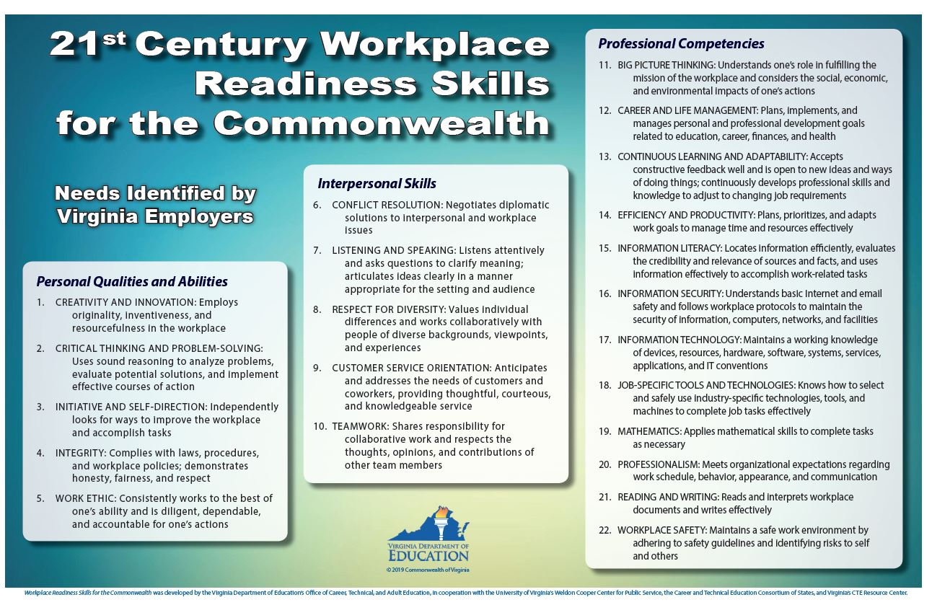
Workplace Readiness Skills (WRS)
A set of personal qualities, people skills, and professional abilities identified by Virginia employers and educators as essential for employee success in the workplace.
Skills that are the first 22 competencies in every CTE curriculum framework
  Personal Qualities and Abilities
  Interpersonal Skills
  Professional Competencies

Slide 26
Training Agreement
Provides an outline of a written commitment made by the student, parent/guardian, WBL coordinator/teacher, and employer that outlines the roles and responsibilities of each stakeholder
Required to be on file for each student for ALL WBL experiences
Provides protection to the WBL coordinator/teacher and school officials against accusations of negligence and liability claims
May be modified as appropriate by each program area or school division, but must include the Virginia Department of Labor and Industry (VDOLI) requirements
Notes:
Training Agreement
A key component of a quality WBL program is maintaining accurate records for each student's WBL experiences.
Training Agreements provide an outline of a written commitment made by the student, parent/guardian, WBL coordinator/teacher, and employer that outlines the roles and responsibilities of each stakeholder
Clinical Affiliation Agreements are developed by the instructor, but regulated by individual health science state boards
Youth Registered Apprenticeship Agreements are developed by the Virginia Department of Labor and Industry in conjunction with a consultant
Required to be on file for each student for ALL WBL experiences
All WBL experience forms must be retained for each student for 5 years after a student graduates then destroyed. This includes all work experience forms associated with a student’s WBL experience such as time logs and evaluations.
Supervised Agricultural Experience (SAE) Agreement is required for SAE Immersion Placement and Ownership experiences
Provides protection to the WBL coordinator/teacher and school officials against accusations of negligence and liability claims
May be modified as appropriate by each program area or school division, but must include the Virginia Department of Labor and Industry (VDOLI) requirements
VDOLI language includes the asterisked and italicized items found in the templates provided in the WBL Guide and listed on the next slide

Slide 27
Training Plan
Identifies the classroom instruction and workplace training that will contribute to the employability and ongoing development of a student
Required for Internship, Entrepreneurship, Cooperative Education and Supervised Agricultural Experience (SAE) - Immersion
Prepared jointly by the WBL coordinator/teacher, employer, and student
Developed and revised according to the changing needs of the employer
Serves as a record of student progress and documentation for evaluation
Notes:
Training Plan
The Training Plan:
Identifies the classroom instruction and workplace tasks/responsibilities that will be performed during the WBL experience.
Is required for Internship, Entrepreneurship, Cooperative Education and Supervised Agricultural Experience (SAE) - Immersion
Apprenticeships may have additional required documents that are governed by regulations in their respective areas. If you have questions about additional required documents for apprenticeships see the WBL Guide page 148. You may also contact your regional Virginia Department of Labor Registered Apprenticeship consultant.
Is prepared jointly by the WBL coordinator/teacher, employer, and student
Is developed and revised according to the changing needs of the employer
Serves as a record of student progress and documentation for evaluation.
The Training Plan is used for on-site visits throughout the school year to document student progress

Slide 28
Federal and State Labor Regulations
All WBL programs must abide by applicable child labor and workplace safety regulations.
The most strict law applies between the state and federal law
  U.S. Department of Labor, Employment Standards Administration, Wage and Hour Division
  Virginia Department of Labor and Industry (VDOLI), Labor and Employment Law
Students are required to obtain all safety and/or OSHA certifications to perform the necessary job functions included within the WBL experience.
The training plan must meet all U.S. Department of Labor guidelines for student learner exemptions from Hazardous Occupations; see Child Labor Bulletin 101 and 102, and comparison guidelines on the VDOE website.
Notes:
Federal and State Labor Regulations
Safety is important in High-Quality WBL.
All WBL experiences must be in compliance with federal and state child labor laws
Many employers and students may be engaging in WBL for the first time. It is extremely important that you understand and communicate to your employers and students the child labor and workplace safety regulations that govern your specific students and industry.
There are both federal and state child labor laws that must be followed. In the cases where both state and federal laws apply but are different, the most protective law applies.
Students are required to obtain all safety and/or OSHA certifications to perform the necessary job functions included within the WBL experience.
The Training Plan should meet all U.S. Department of Labor guidelines for student learner exemptions from Hazardous Occupations
Once the Training Plan is completed ensure that it complies with guidance regarding hazardous occupations that are prohibited to all minors under 18
Specifically regarding clinical experiences, there may be additional regulations that are outlined by the individual health and medical science state boards
You are not alone in navigating the child labor laws. If you have any questions about child labor regulation contact the Virginia Department of Labor and industry and they will be able to assist or point you to their federal counterparts. Their contact information and additional resources are provided on the next slide.

Slide 29
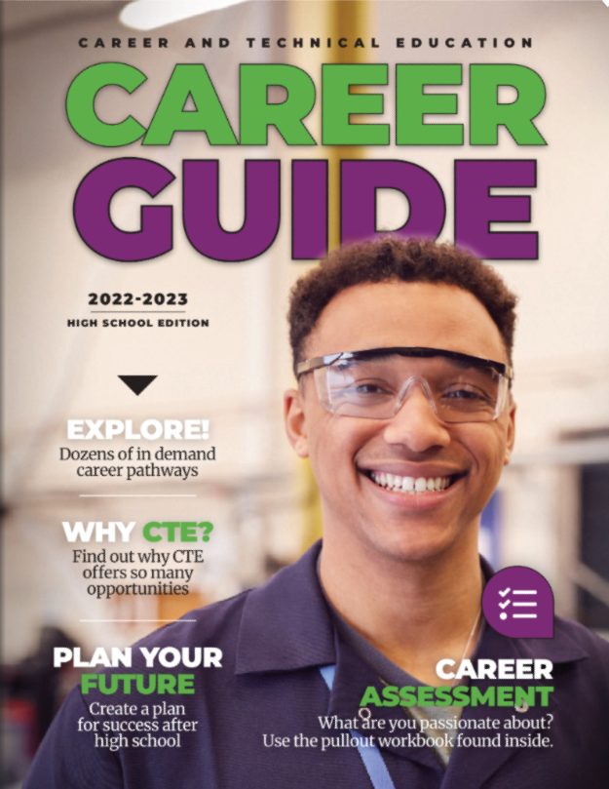
CTE Career Guide

Slide 30
Dr. Tricia Jacobs
Director, CTE & Workforce Development
Cell Phone #: 540.850.5262
Office Phone #: 703.619.8020
tricia.jacobs@acps.k12.va.us

